Slide 1
02-02. Experimental environment setup
Dept. of Computer Information & Science
Youngsoo Kim <pineland@hanmail.net>
Code : https://github.com/pineland/AIDA/

Slide 2
Outline
Anaconda concept, installation
Conda concept, commands
Jupyter notebook concept, commands

Slide 3
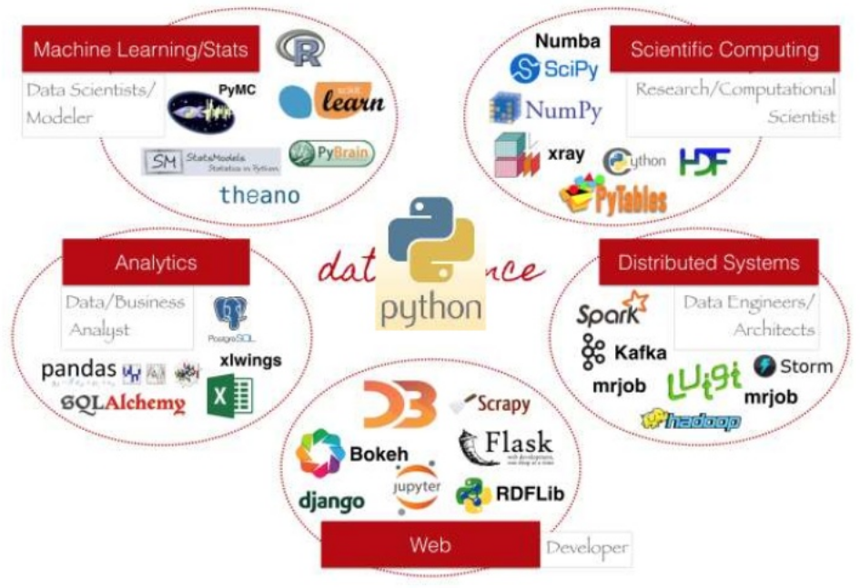
Programs for data science

Slide 4

What is Anaconda?
Anaconda is a Python distribution that is most popular for data analysis and scientific computing
Open source project developed by Continuum Analytics, Inc.
Available for Windows, Mac OS X and Linux
Includes many popular packages: NumPy, SciPy, Matplotlib, Pandas, IPython, Cython
Includes Spyder, a Python development environment
Includes conda, a platform-independent package manager

Slide 5
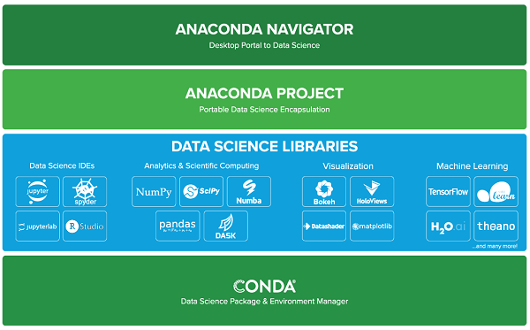
Stack of anaconda

Slide 6
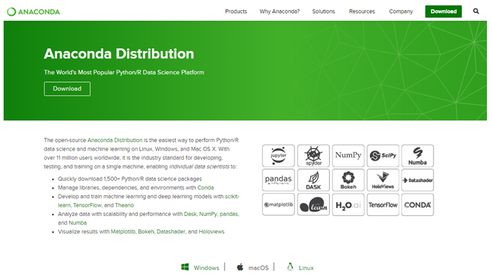
Installing Anaconda
Anaconda is easy to install
Download from https://www.anaconda.com/distribution/
Execute the installer and follow the instructions
Scroll down for download

Slide 7
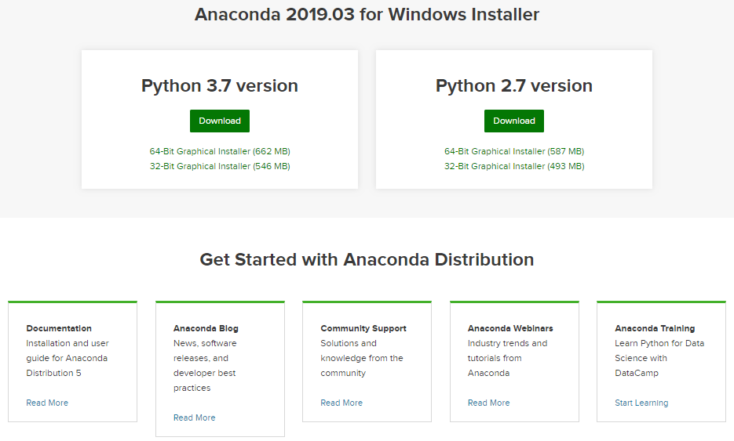
Download and install for your PC

Slide 8
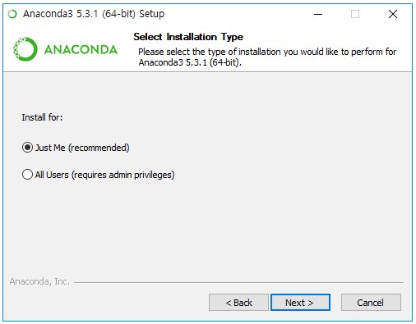
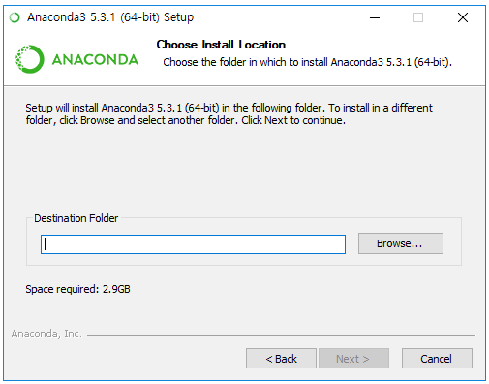
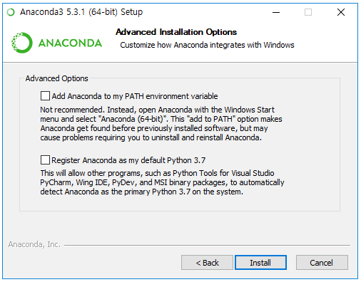
Environment setup
√

Slide 9
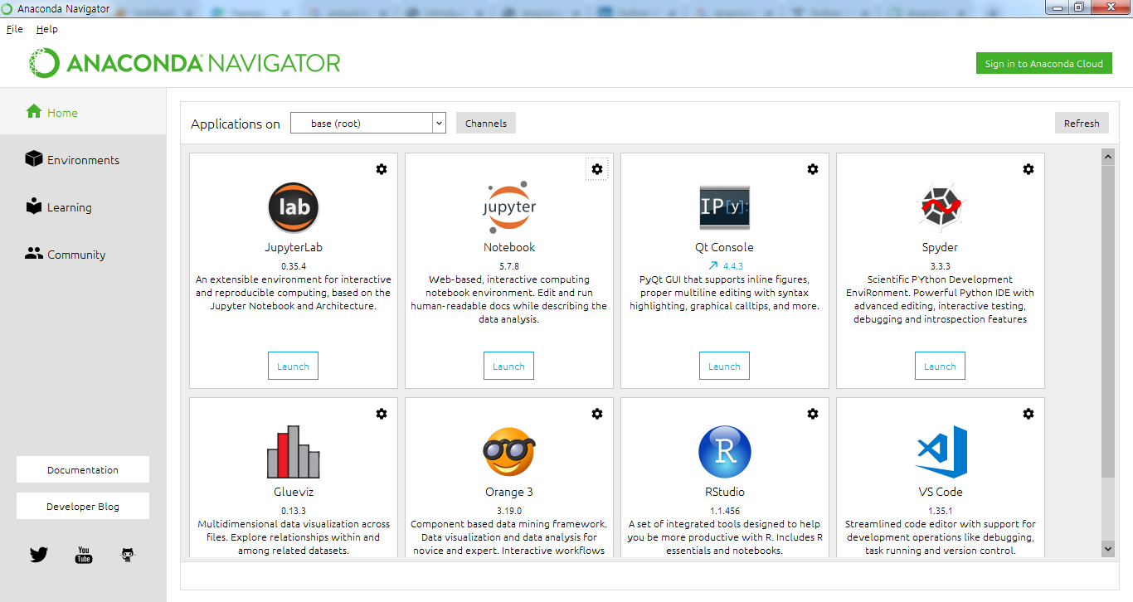
Installation completed and run screen

Slide 10
Introduction to Conda
Simplifies installation of Python packages
Platform-independent package manager
Doesn’t require administrative privileges
Installs non-Python library dependencies (MKL, HDF5, Boost)
Provides ”virtual environment” capabilities
Many channels exist that support additional packages
Documentation at http://conda.pydata.org.docs/

Slide 11
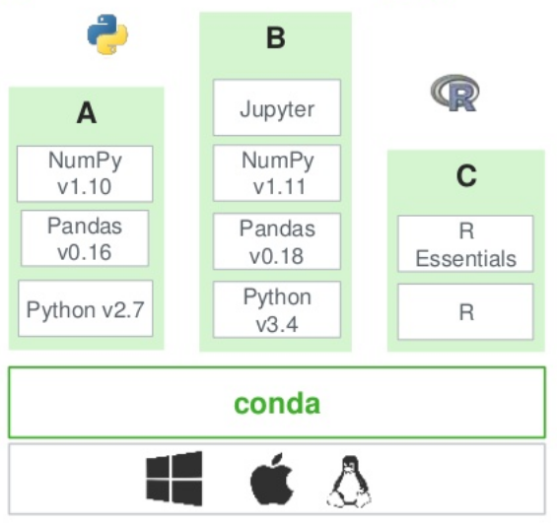
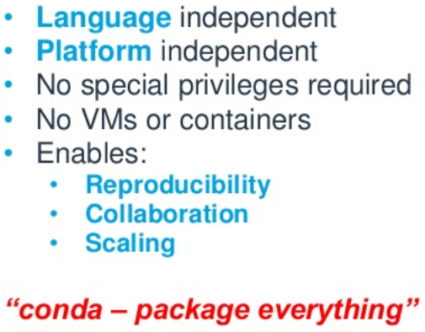
Conda Sandboxing technology

Slide 12
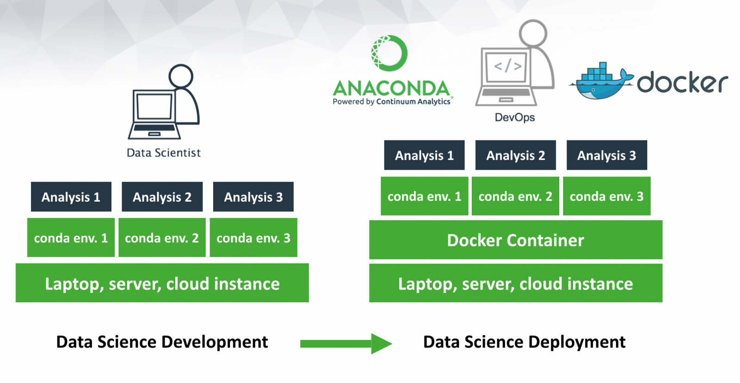
Conda for deployment

Slide 13
Warning(tips) about installing/updating packages
Installing packages into existing environment may cause problems
Best to install all necessary packages at same time.
Install command may ask permission to update existing packages which may result in version conflicts.
Install packages into new environments if possible to avoid conflicts.

Slide 14
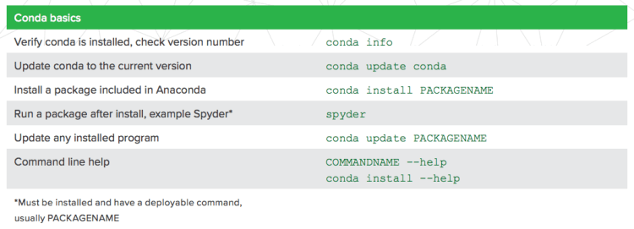
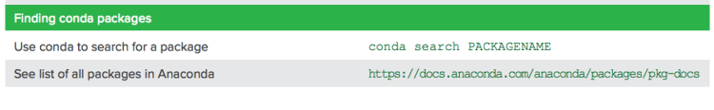
Conda commands (1)

Slide 15
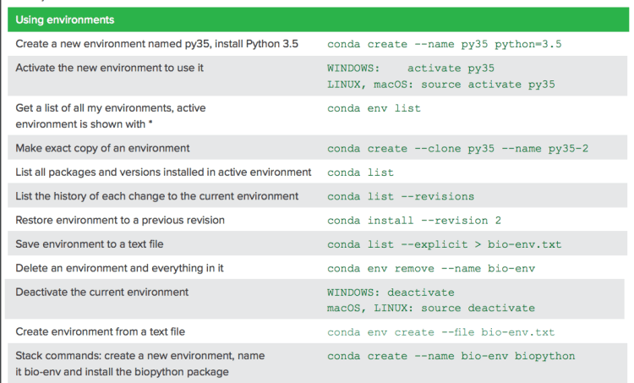
Conda commands (2)

Slide 16
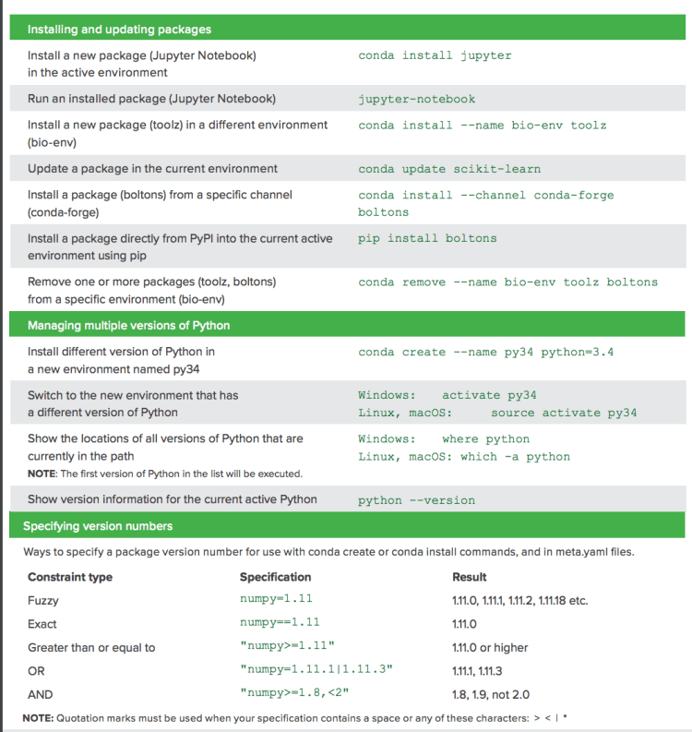
Conda commands (3)

Slide 17

What is jupyter notebook?
Jupyter notebook
a part of Project Jupyter, a nonprofit to develop open-source software, standards, and services for interactive computing across dozens of programming languages
originated from Ipython, released in 2001, is a command line shell which enables interactive computing using Python and many other programming languages.
Can be used as an interactive front-end to parallel computing technologies and applications.
Can be used for data science.

Slide 18
Jupyter notebook use
Uses include interactive:
data science
statistical modelling
big data
machine learning
data cleaning and transformation
interfacing with parallel back-ends (e.g., Hadoop, Spark)
interchanging data across programming languages

Slide 19
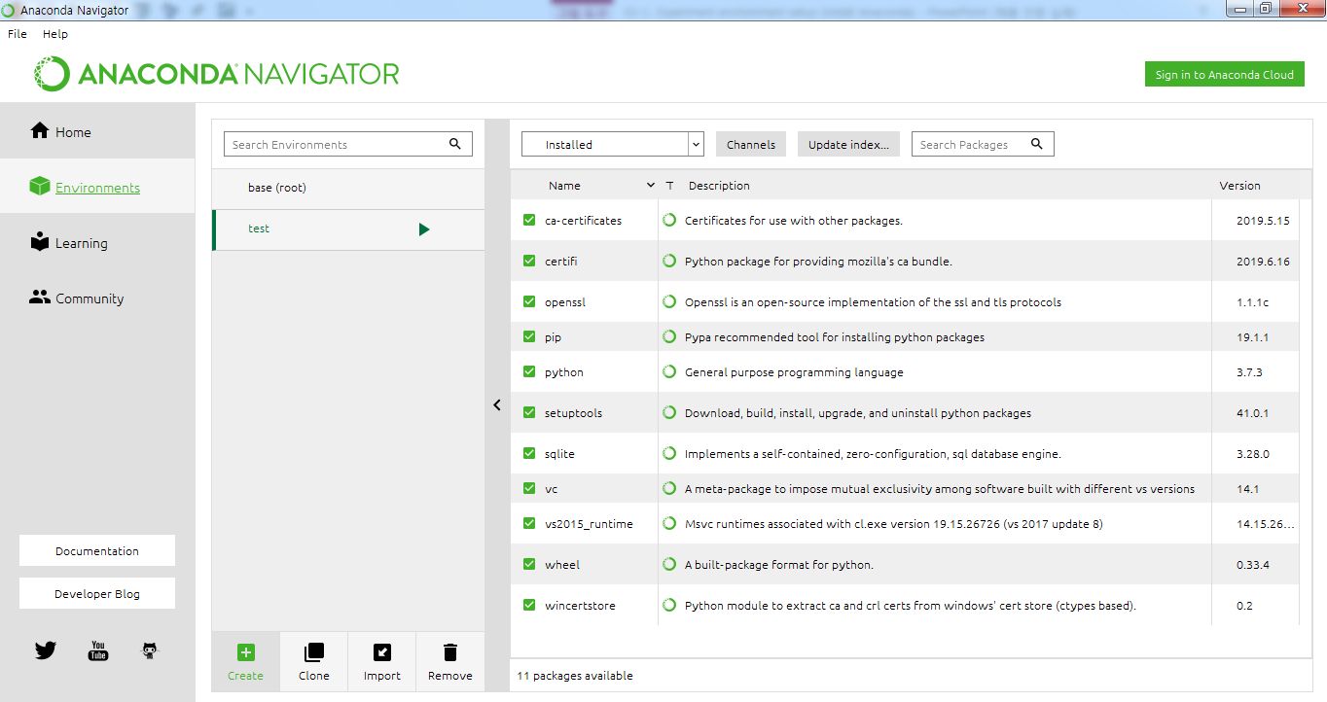
How to use jupyter notebook (1)
1. Create a channel (virtual environment) using conda
또는
$ conda create --name test python=3.7

Slide 20
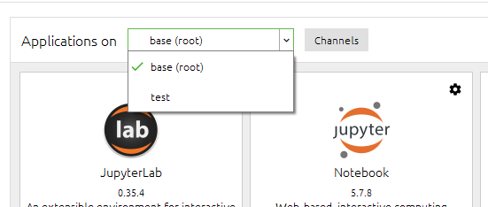
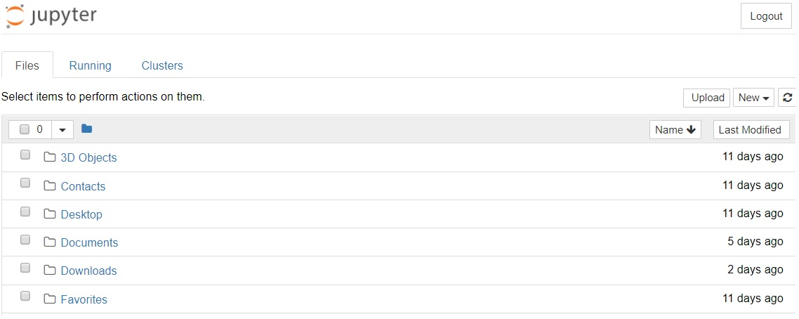
How to use jupyter notebook (2)
Select a channel and run jupyter notebook

Slide 21
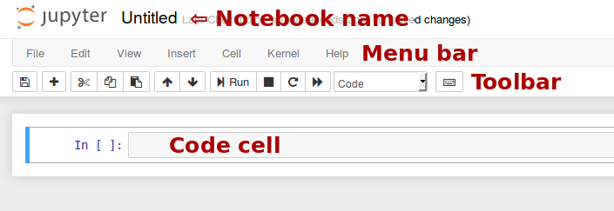
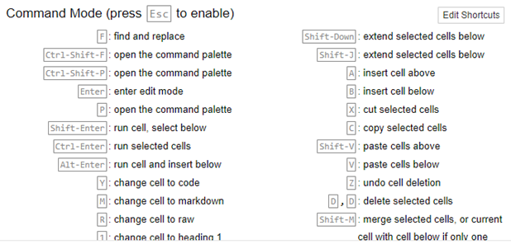
How to use jupyter notebook (3)
Demo

Slide 22

Q & A

